Slide 1

CIMCYC Workshop Computational modelling of behavioral data
2nd June 2022

Slide 2




Schedule
09:30
Introduction to computational models on decision making
10:00
Distributional analyses and Drift Difussion Model (DDM)
11:30
Hands-on session on DDM
----- LUNCH ------
15:00
Introduction to computational models on reinforcement learning (RL)
15:30
RL theory
17:00
Hands on session on RL
Carlos
Luc
Javier
Francesco
All slides and materials are availabe at: https://github.com/ortiztud/cmb

Slide 3
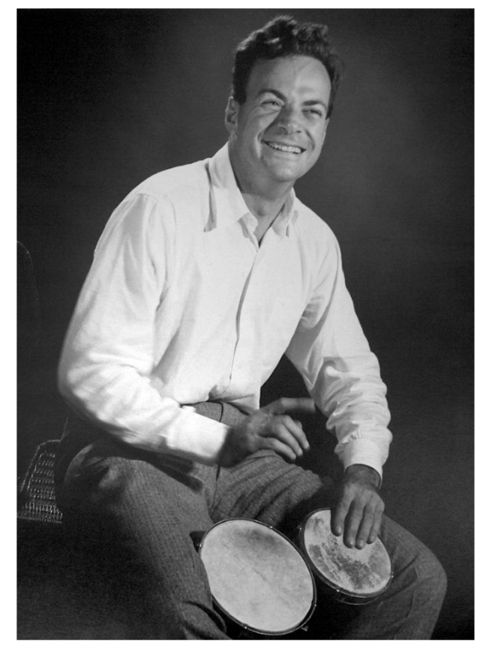
Why (cognitive) modelling?
“What I cannot create, I do not understand”.
—Richard Feynman

Slide 4
What is (cognitive) modelling?
“In cognitive neuroscience, modeling is a tool to help construct better theories of cognition and behavior”
(Verguts, 2022)
Models allow for making novel predictions that don’t obviously follow from the theory
Models allow integration of existing data in a well-organized conceptual framework

Slide 5
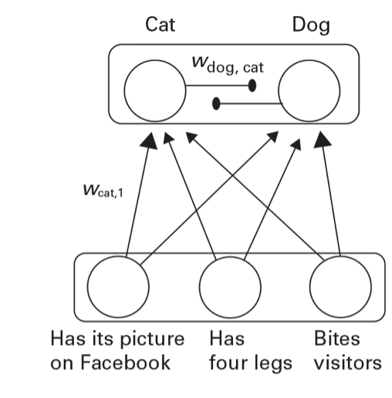
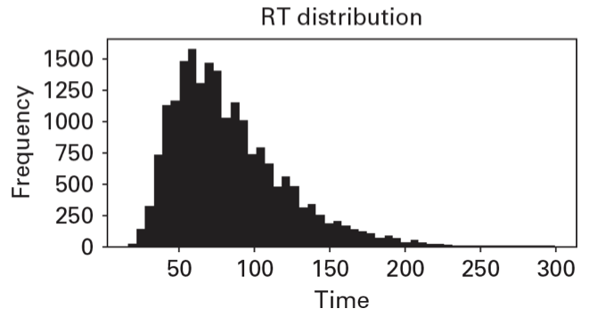
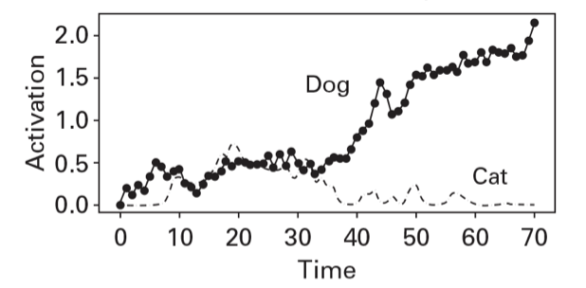
Modelling decision making
Decision making can apply to any situation where an agent must choose between two or more actions
“Is this a cat or a dog?”
Trajectories of Cat and Dog detectors in trial t

Slide 6
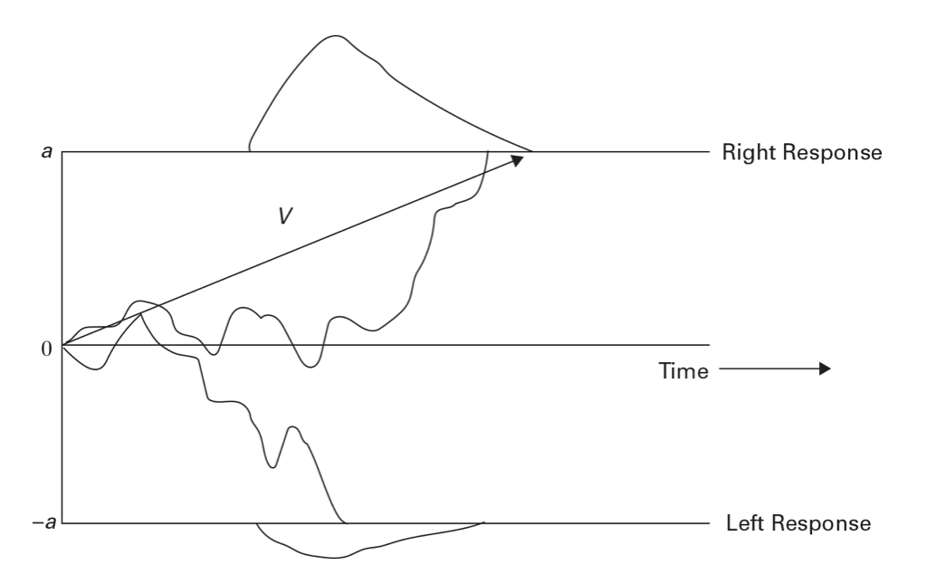
Modelling decision making – the Drift Diffusion Model
Popularized in Psychology by Ratcliff (1978)
In the DDM, a key aspect is the difference between the activations of the different (e.g. cat / dog) detectors
When the difference reaches a threshold, the model decides that the stimulus is a dog / cat
Trajectories of Cat and Dog detectors in trial t

Slide 7
DDM main parameters
DDM models decision making as a noisy accumulation of evidence
Main parameters:
Drift rate (v): average slope of the decision trajectory, that is, speed of information uptake
Threshold separation (a): amount of information considered a decission
Starting point (z): point where the accumulation process starts. Reflects bias towards one of the thresholds
Nondecision time (t): it captures all processes not related to the decission process. Reflected in rightward shifts in the RT distribution

Slide 8
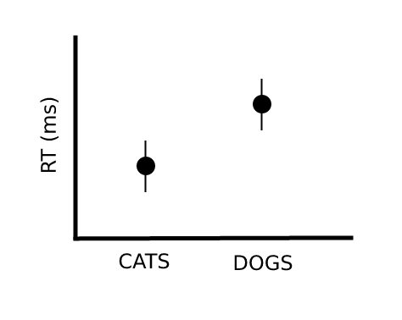
DDM in Psychology
Very popular in Psychology because it allows to fit RT and ACC simultaneously (i.e. common behavioral metric)
﻿Different cognitive processes are mapped to different psychologically meaningful parameters.
Moreover, these parameter estimates are less noisy than RT or ACC alone, which improves reliability and effect sizes
The promise is to gain information not only about whether participants are slower (or less accurate), but also why:
Slowdown of information uptake
Delayed motoric response execution
Bias towards one of the thresholds
Resp 1
Resp 1
Resp 1
drift rate (v)
t
z
Resp 2
Resp 2
Resp 2

Slide 9
DDM in Psychology
DDM disentangles a number of intuitively appealing concepts:
Changes in drift rate can express:
Stimulus quality
Participant ability
Decision difficulty
Changes in threshold can express:
Cautiousness
Speed-accuracy trade-off (higher threshold entail slower but more accurate responses)
Changes in starting point can express preference of a response threshold:
Reward
Priming
Proportion effects
Changes in nondecision time can express:
Differences in basic encoding processes
Configuration of WM for a task
Differences in motoric processes related to response execution

Slide 10
DDM in Psychology
Model(s) creation and optimization
Model-based simulations
Model fit assessment
Model comparison

Slide 11
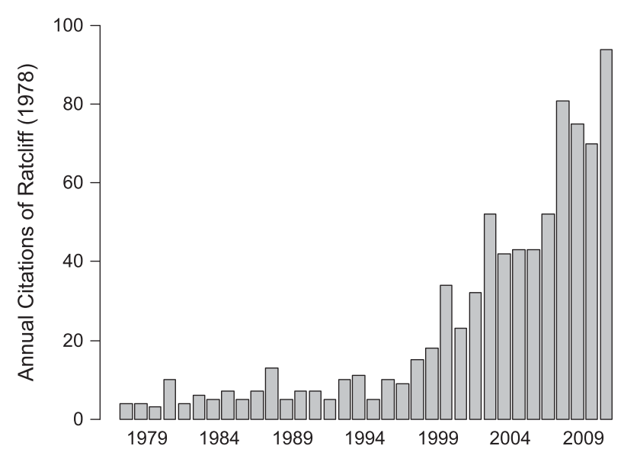
Applications of the DDM
“Basic” cognitive neuroscience
Decision making
Cognitive control
Working memory
Attention
ADHD
Aging
Psychiatric disorders
Dyslexia
Development
Sleep deprivation
…

